Slide 1



Group1
Aishwarya Nirmal
Mudit Mishra
Manogna Reddy Peddyreddy
Pooja Mahajan
Rahuldeep Shenoy
Sahana Sureshkumar
Vinod Kumar Reddy Parla

Slide 2

Objectives:
Comparison Study on property price and associated attributes.
Predict Zestimate by considering it’s influencing factors.
Making inferences using regression analysis.
Notes:
Manogna

Slide 3
Process Flow
Scrapping
Cleaning
Data Visualization
Insights
Research questions
Data Preparation
Linear Modelling
Notes:
Manogna

Slide 4

Web-scraping describe the use of a program or algorithm to extract and process large amounts of data from the web.
Data extraction involves the retrieval of data from various sources and converting the data to a useful format for further processing or analysis.
SCRAPING
Advantages:
1. Cost-Effective
2. Low Maintenance and Speed(time saving)
3. Data Accuracy
4. Easy to Implement
Challenges:
1. Speed and Protection Policies
2. Confusing
Notes:
Manogna
To retrieve the data, we have scrapped the meaningful data about the property to infer critical solutions about the Housing Market in the Bay area.
Generating Insights helps in driving decision-making about a property.

Slide 5
Steps for Scrapping
Scrape the property URLs of the properties using Beautiful Soup Library and regex matching.
Extracting the URL for each property in each city ex: Fremont, Sanjose, Dublin.
Using JSON to scrape the data of all the properties. "hdpApolloPreloadedData" (nested jason, apiCache)
Creating data frame and excel for cleaning and Analysis of the data
Used Pandas library "nested_to_record" that will denormalize the JSON into multiple data columns
Notes:
Manogna

Slide 6





Process
1. Scrapped all the properties info in bay area.
2. Data collection of about 1324 unique properties(rows) in the bay area.
3. Captured around 750 unique data points (columns) about each property that are hidden by Zillow.
4. Instead of choosing 10-15 selective columns, we went ahead with scrapping all the existing data about a property as there are few inferred attributes such as HOA, hasCooling (Booleans), which might help in validating data/ Inferring new attributes without scrapping the properties at a later point.
5.We shortlisted around 200 features for data cleaning and analysis.
Notes:
Manogna
We shortlisted around 200 features for data cleaning and analysis.

Slide 7
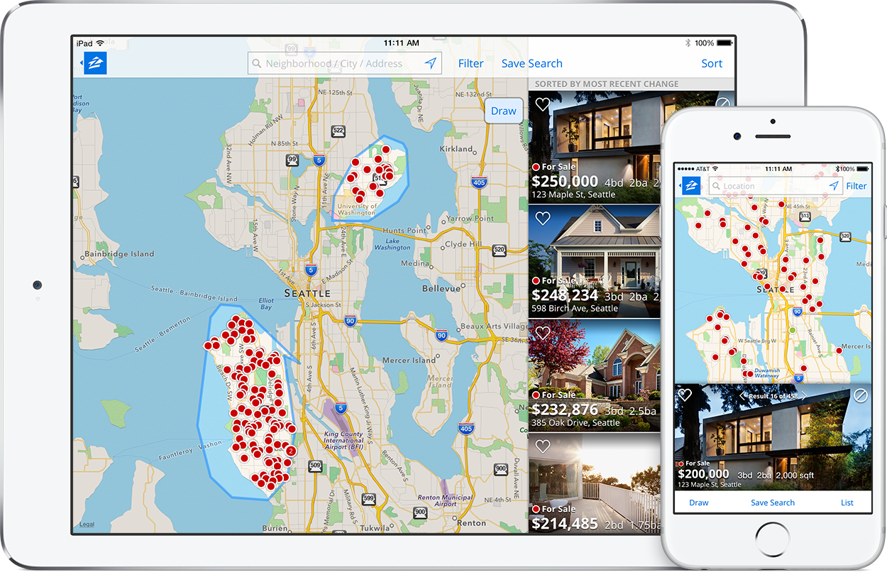
Read Data from File
CLEANING
Read Data from Excel file
Number of Listings - 1325
Features (No of Columns) - 249
Using PANDAS for data frame
Notes:
Pooja

Slide 8
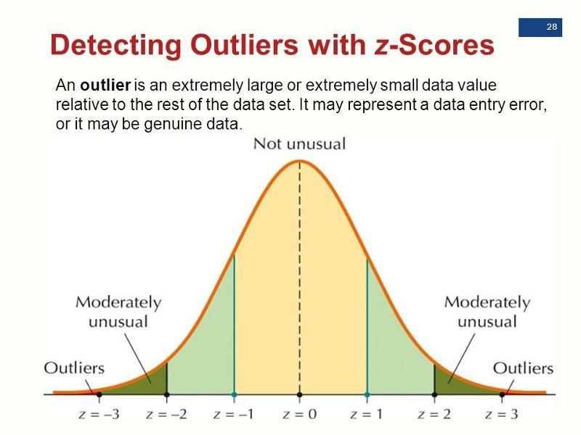
Outliers Removal
Outliers - An outlier is a value that differs significantly from other observations
We used Z score method to remove outliers
Z score = (x - mean) / standard deviation;
x is data point
Listings before outlier removal | Listings after outlier removal
1324 | 549
Notes:
Pooja

Slide 9

Spliting DataFrame
In order to ease out further operations we have to split dataframe into category dataframe and numerical dataframe
Category Dataframe - df_cat= df.select_dtypes(exclude='number')
Numerical Dataframe - df_num= df.select_dtypes(include='number')
Notes:
Pooja

Slide 10
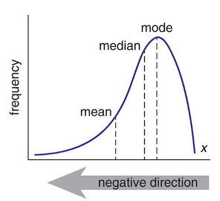
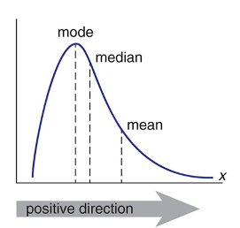

Missing Value Imputation
So far our data is not symmetric; it’s either left skewed or right skewed
We are filling out the missing data using the median and mode values
for x in df_num:
df_num[x] = df_num[x].fillna(df_num[x].median())
for x in df_cat:
df_cat[x] = df_cat[x].fillna(df_cat[x].mode()[0])
Notes:
Aishwarya

Slide 11
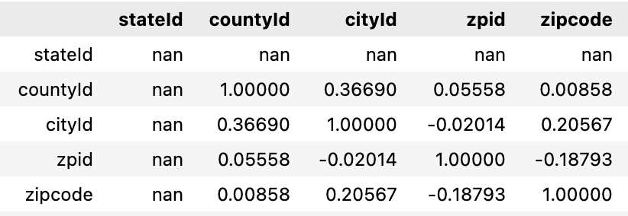
Pearson Correlation Coefficient
Pearson Correlation Coefficient is the test statistics that measures the statistical relationship, or association, between 2 continuous variables
Best method of measuring the association between variables of interest because it is based on method of covariance
It gives information about the magnitude of the association, or correlation, as well as the direction of the relationship
Using Pearson Correlation Coefficient we have narrowed down the features that influence zestimate
Notes:
Aishwarya

Slide 12
Multicollinearity Removal
Multicollinearity occurs when independent variables in a regression model are related to each other; no relation should exist between any independent or predictor variables.
Multicollinearity can cause problems:
Coefficient estimates to swing wildly based on which other independent variables in the model; coefficients become very sensitive to small changes
Reduces the precision of estimated coefficients; which weakens the statistical power of regression model
E.g.: If we include 2 features bedroom and bathroom which are strongly correlated, we need to remove 1 and keep only 1 in final result set
We use VIF (Variance Inflation Factor) iteratively to assess VIF for every independent variable and choose columns that have VIF <= 12.5
Notes:
Aishwarya

Slide 13

Data Visualization
Notes:
Rahul/Vinod

Slide 14
Libraries, Packages & Plots
Packages Fetched:
Plotly
pip install plotly
Folium
pip install folium
Libraries Imported:
matplotlib.pyplot
seaborn
plotly.express
plotly.graph_objs
make_subplots
folium
Functions Implemented:
plotly.express.scatter()
matplotlib.axes.Axes.scatter()
matplotlib.axes.Axes.plot()
matplotlib.axes.Axes.hist()
seaborn.scatterplot()
plotly.express.bar_polar()
seaborn.heatmap()
folium.map()
Notes:
Rahul/Vinod

Slide 15
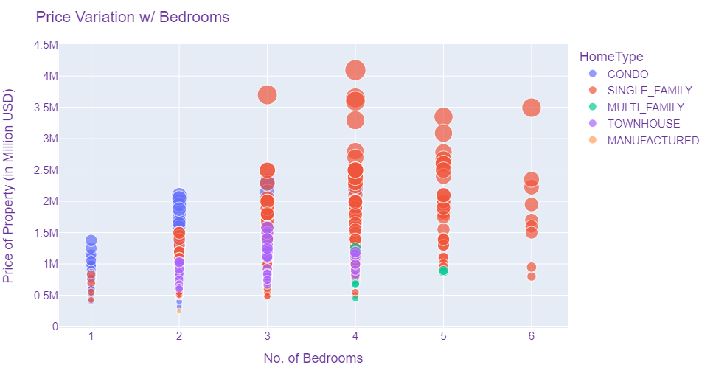
Property Price & Associated Attributes
Comparison Study
Objective:
To analyze the Variation of Property Price with Bedrooms.
Technique:
A scatter plot was mapped with parameters : Property Price, No. of Bedrooms, with Home Type taken as the marker.
Observations:
It is observed that, as the No. of Bedrooms in a Property increase, the Property Price also increases.
Inference:
It is inferred that Property Price has a positive linear relationship with the attribute : No. of Bedrooms.
Notes:
Rahul/Vinod

Slide 16
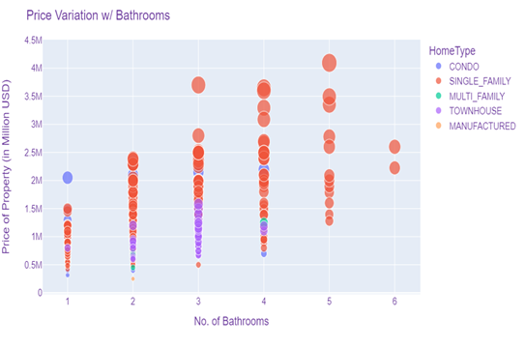
Property Price & Associated Attributes
Comparison Study
Objective:
To analyze the Variation of Property Price with Bathrooms.
Technique:
A scatter plot was mapped with parameters : Property Price, No. of Bathrooms, with Home Type taken as the marker.
Observations:
It is observed that, as the No. of Bathrooms in a Property increase, the Property Price also increases.
Inference:
It is inferred that Property Price has a positive linear relationship with the attribute : No. of Bathrooms.
Notes:
Rahul/Vinod

Slide 17
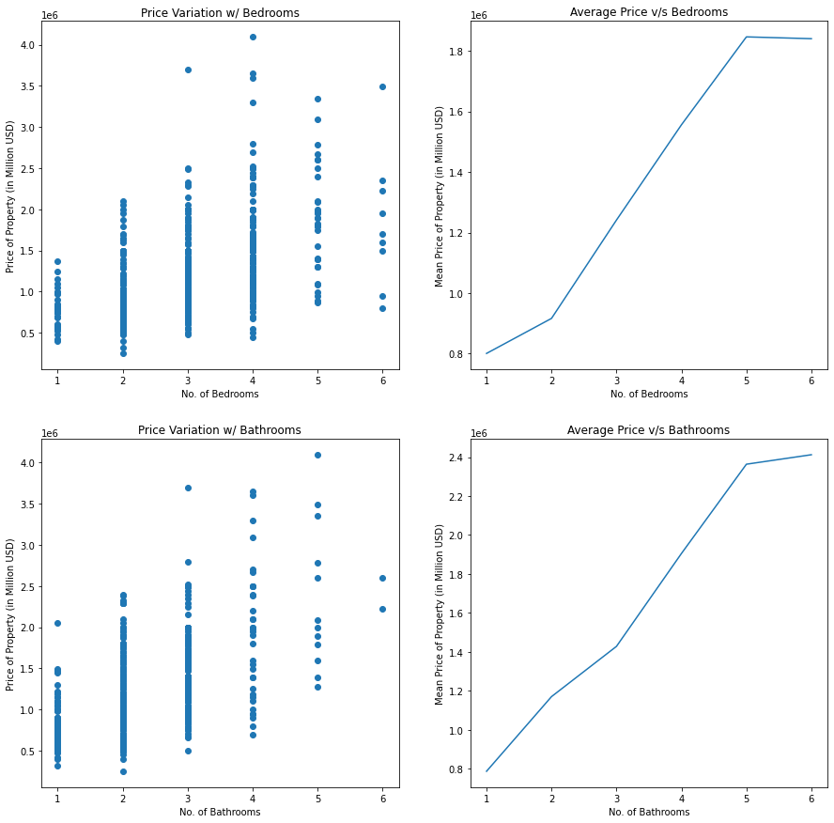
Notes:
Rahul/Vinod

Slide 18
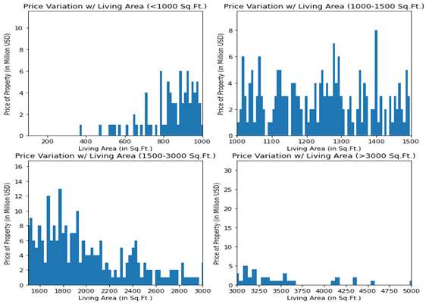
Property Price & Associated Attributes
Comparison Study
Objective:
To analyze the Variation of Property Price with Living Area.
Technique:
A histogram was plotted with parameters : Property Price, Living Area; with Living Area partitioned into 4 categories, for a better understanding of the spread.
Observations:
It is observed that, the Property Price increases rapidly throughout a certain bandwidth [800-1800 sq.ft.] and then stabilizes [1800-2400 sq.ft.] and finally drops after a threshold [3000 sq.ft.]
Inference:
It is inferred that Property Price has curvilinear relationship with the attribute : Living Area.
Notes:
Rahul/Vinod

Slide 19
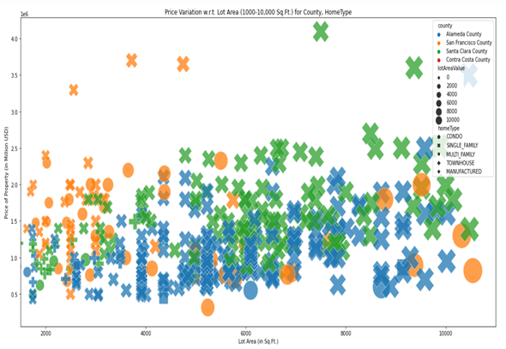
Property Price & Associated Attributes
Comparison Study
Objective:
To analyze the Variation of Property Price with Lot Area.
Technique:
A scatter plot was mapped with parameters : Property Price, Lot Area, with County, Home Type taken as the marker.
Observations:
It is observed that, as the Lot Area of a Property increase, the Property Price also increases.
Furthermore, Single Family & Condo Properties in Santa Clara & San Francisco County are the highest priced properties for a specific range of Lot Area.
Inference:
Property Price has a positive linear relationship with the attribute : Lot Area.
Notes:
Rahul/Vinod

Slide 20
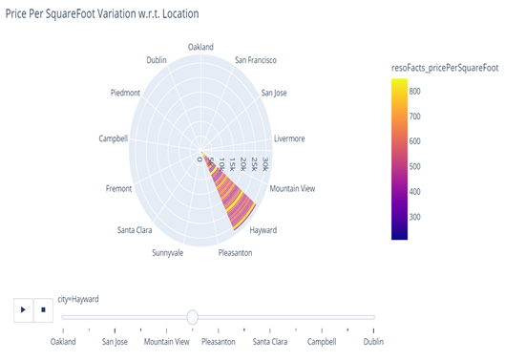
Property Price & Associated Attributes
Comparison Study
Objective:
To analyze the Variation of Price Per Sq.Ft. of Property within a Location for different Locations.
Technique:
A bar polar chart was plotted with parameters : Price Per Sq.Ft., City, with Price Per Sq.Ft. taken as the strength indicator.
Observations:
It is observed that, on an average, within a City, the Price Per Sq.Ft. for property ranges from [$600 - $1200]. Furthermore, the cities: San Francisco, San Jose & Sunnyvale have the Price Per Sq.Ft. on a higher side, whereas the cities: Hayward, Piedmont & Livermore have lower set of values.
Inference:
Price Per Sq.Ft. is strongly influenced by the attribute : City.
Notes:
Rahul/Vinod

Slide 21
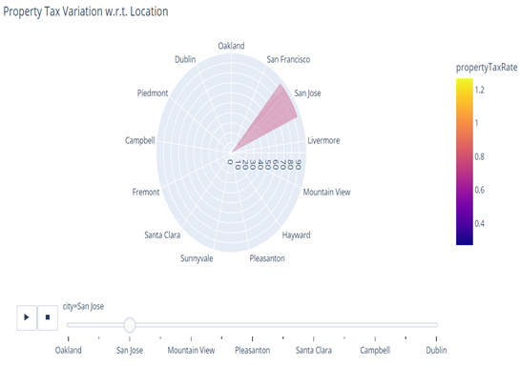
Property Price & Associated Attributes
Comparison Study
Objective:
To analyze the Variation of Property Tax of Property within a Location for different Locations.
Technique:
A bar polar chart was plotted with parameters : Property Tax, City, with Price Property Tax taken as the strength indicator.
Observations:
It is observed that, on an average, within a City, the Property Tax rate for property ranges from [0.60-0.80]. It is also noted that within a county most of the cities have a similar Property Tax rates. Furthermore, the city: San Francisco has the lowest Property Tax whereas the cities: Fremont, Oakland, Dublin have the highest rates for Property Tax.
Inference:
Property Tax is influenced by the attribute : City.
Notes:
Rahul/Vinod

Slide 22
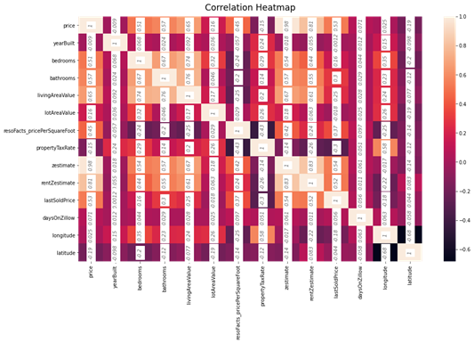
Property Price & Associated Attributes
Comparison Study
Objective:
To identify relationships among the different attributes of the property in a way that can be interpreted numerically.
Technique:
A heatmap was plotted on the dataframe with all the numeric attributes within the dataframe taken as the parameter.
Interpreting Correlation from the Heatmap:
Correlation is a numerical description of the linear relationship between two variables.
It describes the amount of change in one variable in response to a unit change in another variable.
In this heatmap, each of the squares show the correlation between the variables on each axis.
The diagonals are all 1 because those squares are correlating each variable to itself (so it's a perfect correlation.)
Notes:
Rahul/Vinod

Slide 23
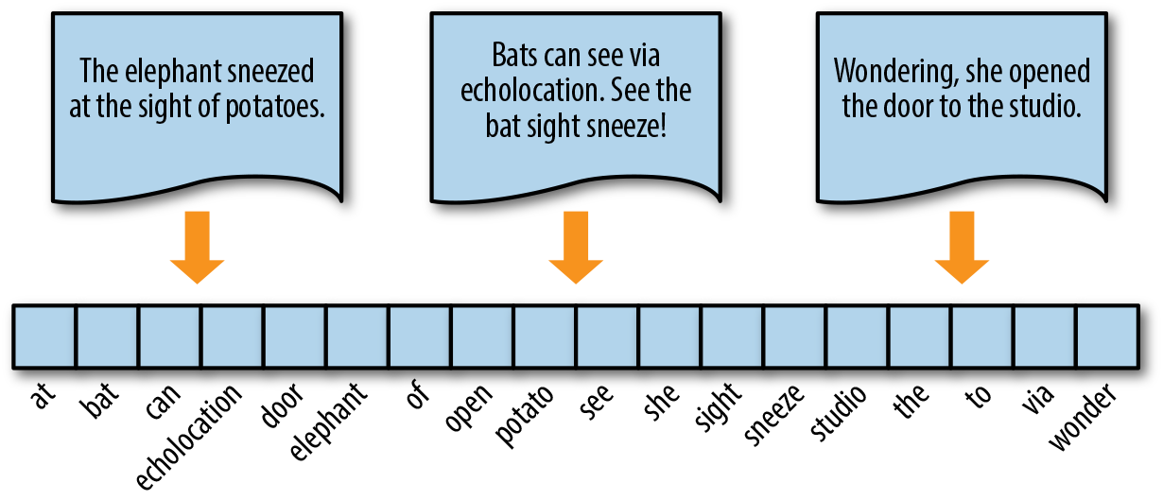
TFIDF Vectorization (Categorical Data Preparation)
TFIDF - Transforms text to feature vectors that can be used as input to estimator
We are using it to convert category data into set of binary features
Vectorization of data makes the process of computation much faster as compared to Unvectorized Implementation, CPUs provide direct support for vector operations where a single instruction is applied to multiple data.
Notes:
Sahana(Categorical data prep)

Slide 24
Numerical Data Preparation
We convert numerical data into valid format for machine to process easily
We standardized our numerical features to bring everything at the same level using the mean and standard deviation
X_train_num_processed = stack((X_train_num_processed,scaled_train)).to_csr()
X_test_num_processed = stack((X_test_num_processed,scaled_train)).to_csr()
Notes:
Sahana

Slide 25
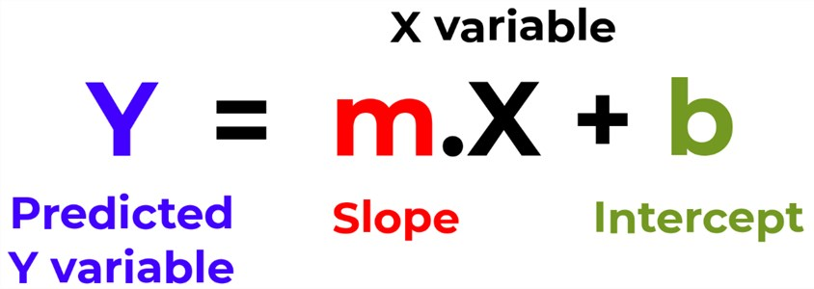
Linear Regression
Linear Regression analysis is used to predict the value of a variable based on the value of another variable.The variable for which we predict the value is called dependent variable and the variables which are helping to do so are called independent variables.
Here, Y is our Zestimate and X’s are our independent variables like bedrooms, fireplace, lot area value, city, etc.
We are using regression model for:
1- Predicting Zestimate.
2- Making inferences.
Notes:
Mudit
(Calculating z estimate)

Slide 26
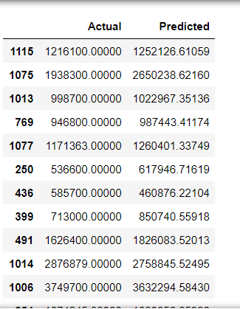
Prediction
Zestimate values
Calculated Actual zestimate VS Predicted zestimate
Df = pd.Dataframe({‘Actual’: Y_test, ‘Predicted': Y_pred})
Actual Zestimate - Calculated by Zillow
Predicted Zestimate - Predicted by our linear model
Notes:
Mudit
(predicting Z estimate)

Slide 27
R-squared
How to measure the goodness of fit of a regression model?
Tells us how well the regression line predicts actual values
Is a measure of how close each data point fits to the regression line
Has values between 0 and 1, value closer to 1 is better
Our model has R-squared value 0.94
Notes:
Mudit
(how good is our model)

Slide 28
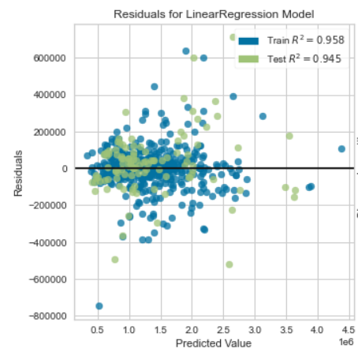
Residual Plot
Residual = Actual - Predicted
We plot Residuals on y axis and Predicted value on x axis.
If you can detect a clear pattern or trend in your residuals then your model have a room for further improvement.
Notes:
Mudit
(how good is our model)

Slide 29
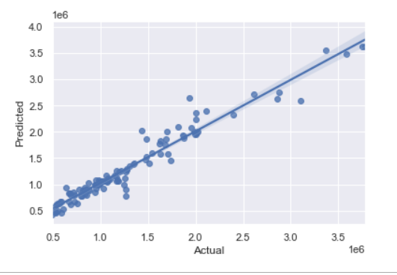
Actual zestimate
VS Predicted zestimate
Scatter plots of Actual VS Predicted are one of the richest form of data visualization; ideally all the points should be close to a regressed diagonal line
E.g.: If actual value is 5, predicted value should be reasonably close to 5
Draw a diagonal line and plot the values on the graph, if the value of R-squared(R^2) is high all the points would be close to this diagonal line; lower the R^2, weaker the goodness of fit of your model and more dispersed are the points from the diagonal
Notes:
Mudit

Slide 30
Regression Coefficients
Relationship between independent and dependent variables is well explained by the coefficient associated with the independent variables in regression model.
The sign of each coefficient indicates the direction of the relationship between a predictor variable and response variable
A positive sign indicates that as the predictor variable increases, the response variable also increases
A negative sign indicates that as the predictor variable increases, the response variable decreases
The coefficient value represents the change in the response given a one unit change in predictor
E.g.: If a coefficient is +3, the mean response value increases by 3 for every one unit change in predictor
Notes:
Mudit

Slide 31
Independent Variable | Non-standardized Coefficient | Standard Coefficient
Price | 0.956 | 0.88
Lot Area Value | 0.17 | 0.0076
Bedroom | 12119 | 0.029
Fireplace | 25885.3 | 0.019
Notes:
Mudit

Slide 32
Inferences from our interpretation
1. How is our zestimate affected if we increase our listing price by $1k?
A: If listing price increases by $1k, our zestimate will increase by $956
2. What will our new zestimate be if we build one more bedroom while keeping all other features constant?
A: Zestimate will increase by approximately $12119
3. What will be the new zestimate of a house listed at $500k if a new fireplace is added?
A: New zestimate will be approximately $526k
4. Which feature, bedroom or fireplace is more important while calculating zestimate?
A: Bedroom is more important in calculating zestimate as it has higher coefficient associated with it
5. How much more important is the bedroom feature than the fireplace feature?
A: Bedroom feature is approximately twice more important than fireplace feature
Notes:
Mudit
(Inferences from interpretation)

Slide 33

Notes:
Mudit

Slide 34
Thank you!

